Slide 1
Workload solution Tech talk: Juju & charms
Xiaogang Zhou, Feng Xia
4/18/2017

Slide 2
Agenda
Juju intro
Charm intro
- demo: states
Charm deploy
- demo: Openstack/Vanilla
Charm development

Slide 3
Juju intro

Slide 4
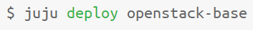
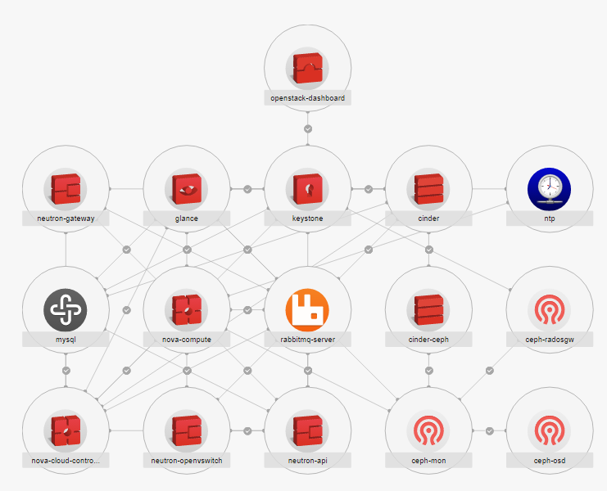
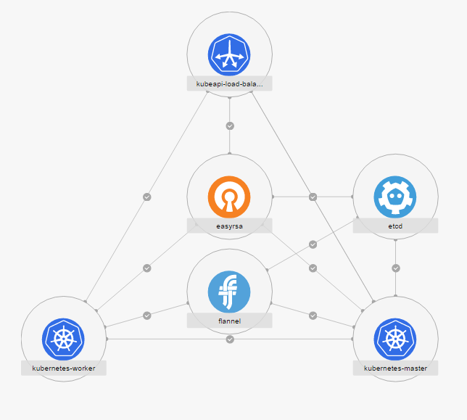
Example use cases
Charm is a workload blueprint, where Juju provides the runtime (orchestrator).

Slide 5
Juju model
Juju binary
$ juju add-machine ….
$ juju deploy mysql
Providers:
Juju environment
Azure
Cloudsigma
Amazon EC2
GCE
Joyent
Openstack
Rackspace
Vsphere
Canonical MAAS
LXD containers
Manual
Manager node
machine-0
Juju agent
provider
Machine
Machine
Machine
Juju agent
Juju agent
Juju agent

Slide 6
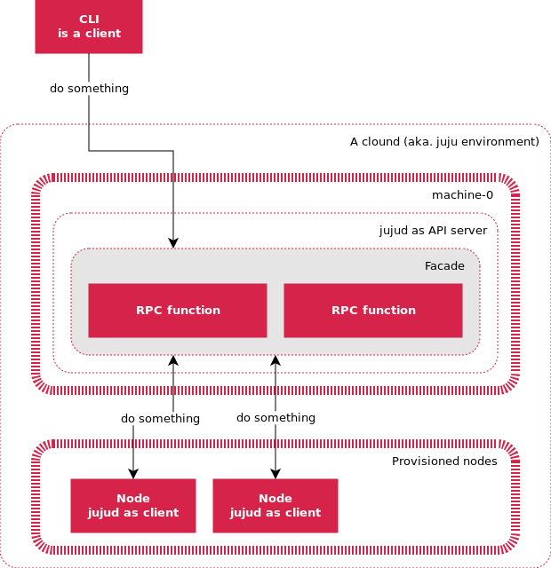
Juju agent
Agent is distributed on each deployment target “machine”.
Agent is installed as part of node provisioning process, then runs as systemd service.
Agent communicates to management node via websocket transportation layer (on server port 17070).
API server provides the same RPC interface for both workload agent and CLI tools.
Agent has a unique ID and credential issued by manager node.

Slide 7
Charm intro

Slide 8
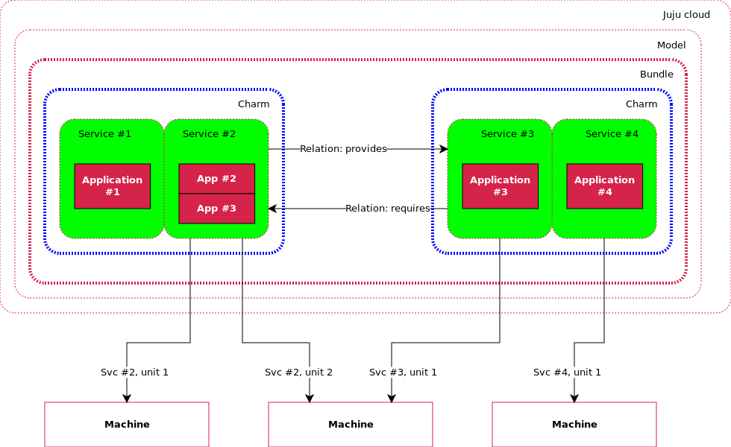
Charm intro
Base unit is a service.
Service can have more than 1 units to achieve HA.
Deployment can be on BM, VM, and LXD container.
Relation pairity
High availability

Slide 9
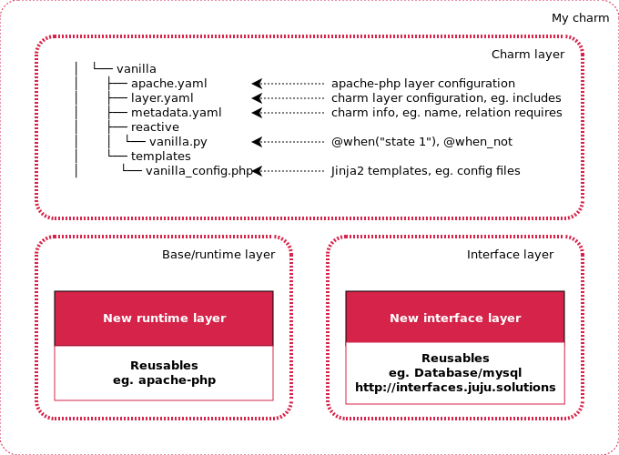
Reactive workload & layer
Base layer
Provides foundation service that can be reused.
Interface layer
Defines service that can be connected to, eg. DB. Parameters are managed by charm; connection method is determined by the application.
Application layer
Defines states, hooks and application logics.
Notes:
Base layer
Interface layer defines service that can be “connected” to, eg. DB. Parameters are passed via interface; how to connect is determined by application, not charm.
Charm layer defines “states”, “hooks”, and application logics.

Slide 10
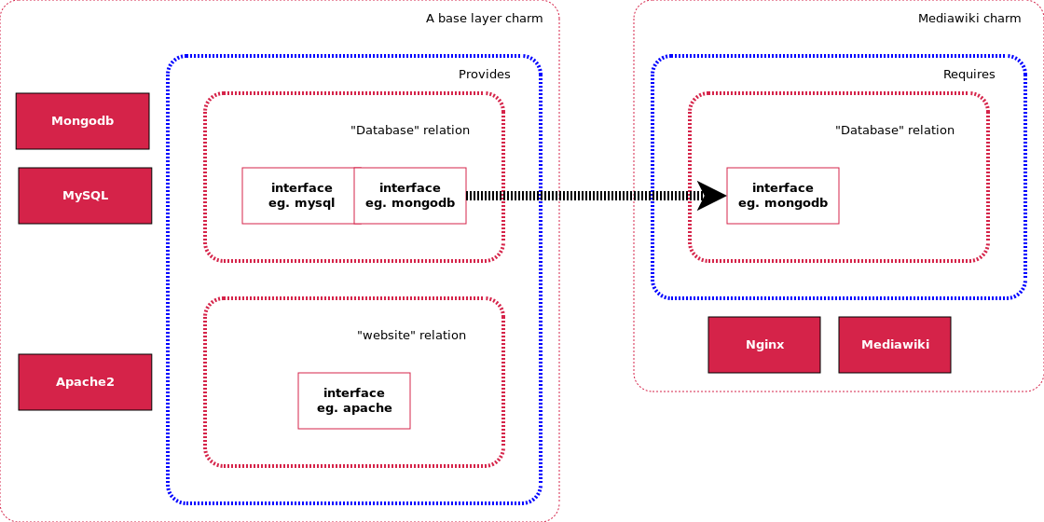
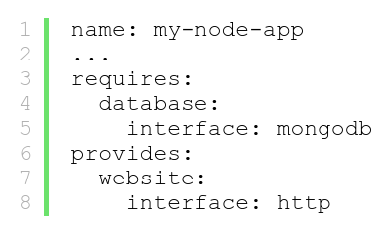
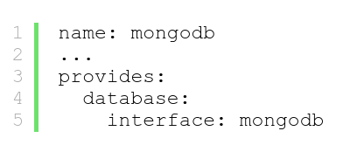
Workload interface sharing
Interface must match
Define a relation category

Slide 11
Hooks
Hooks:
Use @hook(“install”)
Sequence is hard-coded in juju/worker/uniter/operation/runhook.go
install
upgrade-charm
User upgrade
config-changed
start
Hookenv.config() changed
Main loop
User stop
update-status
stop
Timer loop

Slide 12
States
States:
Use @when and @when_not decorators.
Can be split among layers, but not across charms.
Trigger off state transition only => reset in func
Multiple “true” will be executed in serial
How are states executed:
1. Register: charmhelpers.core.hookenv.discover()
all .py under /reactive, /hooks/reactive, /hooks/relations are imported.
all executables files, must support 2 flags:
--test and --invoke
2. Scan: charmhelpers.core.hookenv._run_atstart()
3. Dispatch in two phases: hooks (while) & others (for 1:100) => not interruptable, max 100 states
START
set_state(‘state.1’)
State.1
set_state(‘state.2’)
State.2
set_state(‘state.1’)
set_state(‘state.3’)
State.3
Demo: chained states
Notes:
@when_not(‘a’)
Def this():
set_state(“b”)
pass
@when(‘b’)
Def that():
set_state(“c”)
pass
Import time
time.time() => 9834092492094.998
time.ctime(time.time()) => Fri 10:17 May 01, 2017
with open(“/tmp/juju.log”,’a’) as f:
f.write()

Slide 13
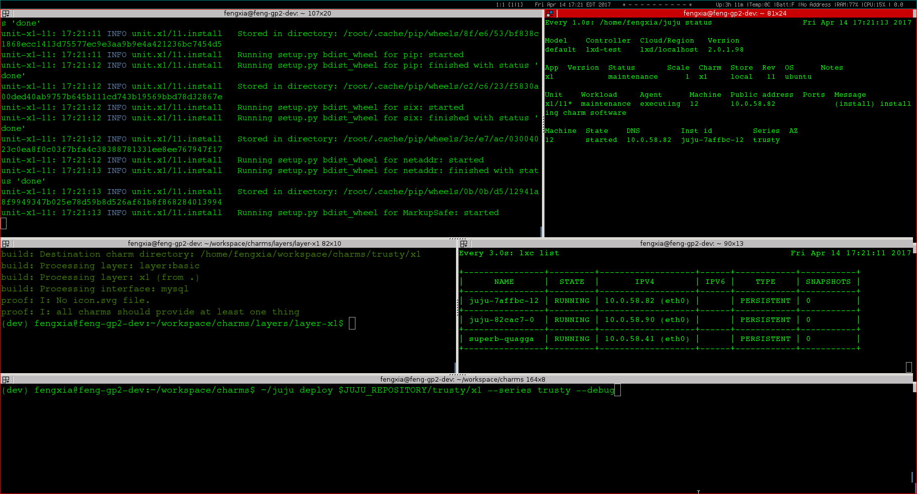
Demo: chained-states

Slide 14
Charm deploy

Slide 15
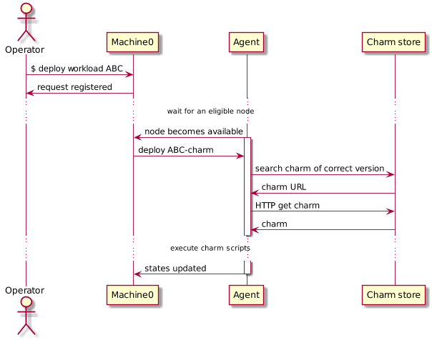
Workload orchestration sequence diagram
Machine-0
Manager node. One per cloud environment. Keep agent states, serve CLI request, and command agents.
Agent
Runtime workload orchestrator. Distributed on each target node.
Charm store
Workload repository. Can be both local & remote.

Slide 16
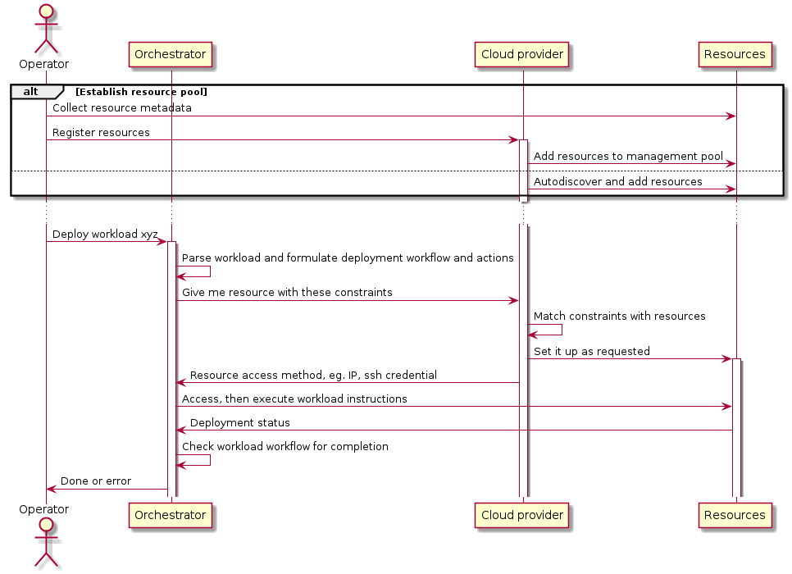
Deployment pattern 1 – pooled resource
Notes:
Pattern 1: resources metadata are registered before they become available for consumption, whereas in pattern 2 resource is created on the fly.

Slide 17



Juju+MaaS setup
VM #1
Issue JUJU CLI
Management network
10.240.216.0/23
MaaS provider
MaaS REST API
MAAS
rack controller
VM #2
Provision network
192.168.100.0/24
DHCP, image
Workload
XYZ
JUJU
Machine-0
Manager node
VM #N
VM #3
JUJU
GUI
VM #4
BM

Slide 18
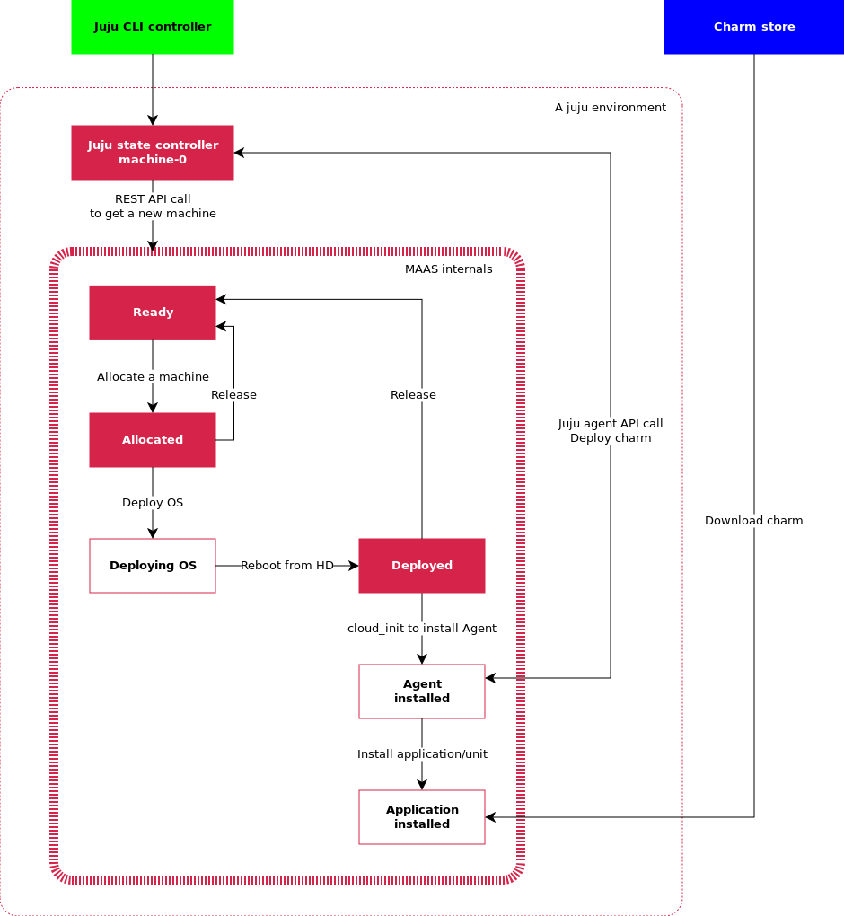
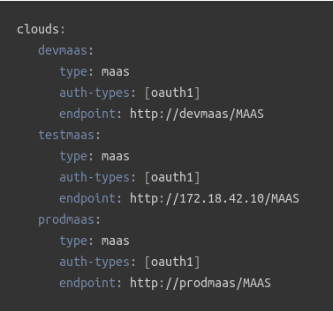
Pattern 1 example – Juju + MaaS
Prepare MaaS and BM nodes – NEW, commissioning, READY
Bootstrap Juju environment – create manager node, aka. Machine-0
To add a cloud:
$ juju add-cloud devmaas maas-clouds.yaml

Slide 19
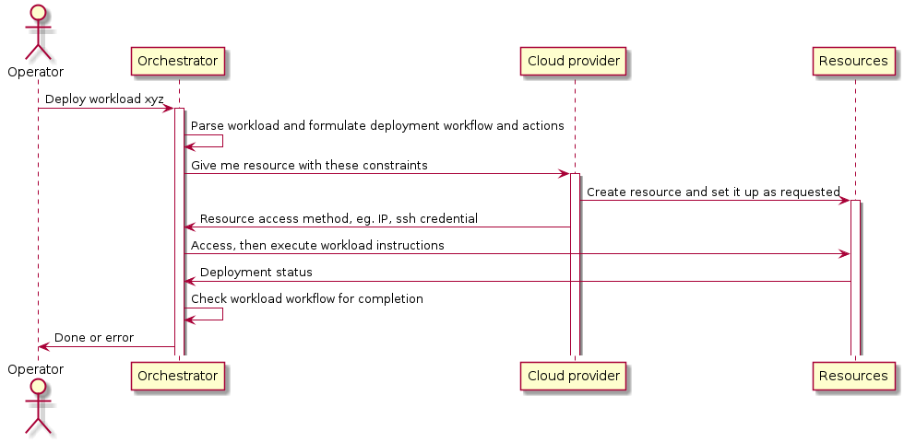
Deployment pattern 2 -- ondemand
Notes:
Pattern 2: is an ideal that resource can be created on the fly, which is observed in juju creating LXD container when deploying workload, eg. openstack base. In the end, we want the entire system appear to operator to have this capability by hiding complexity within the system.

Slide 20
Juju+LXD setup
Issue JUJU CLI
lxdbr0
veth
veth
veth
Container internal network
192.168.100.0/24
eth0
eth0
Workload
XYZ
JUJU
Machine-0
Manager node
CT #N
eth0
CT #3
JUJU
GUI
CT #4
LXD containers
VM #1

Slide 21
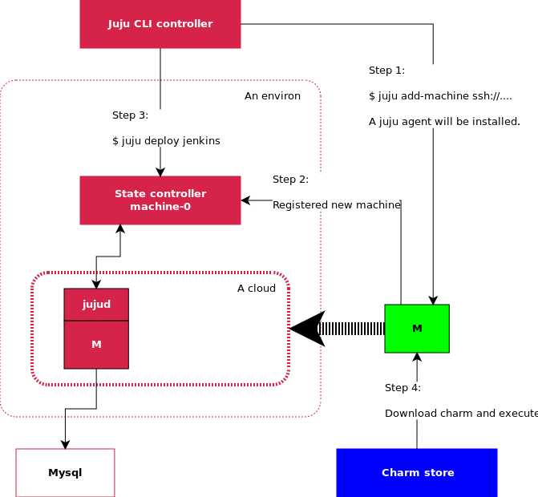
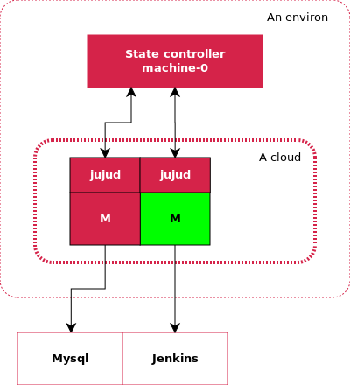
Before & After
Before
After

Slide 22
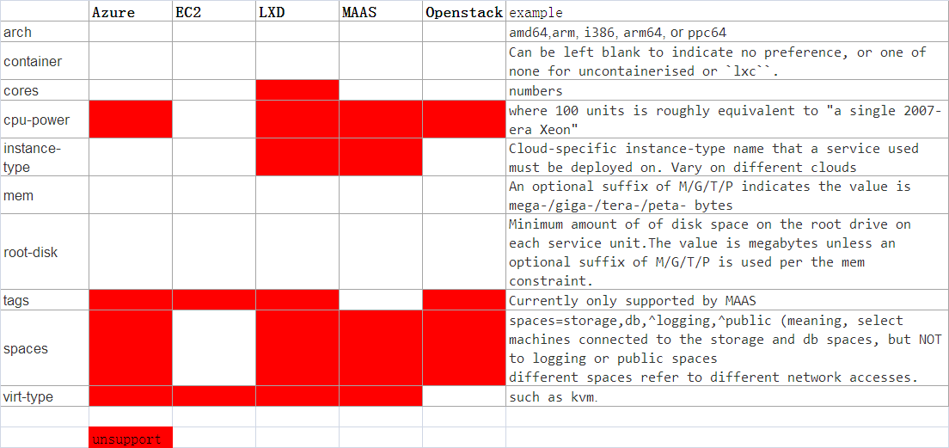
Constraints
juju CLI switch: --constraints mem=4G cores=2
Environment (boostrap) constraints are used as default. CLI can overwrite case-by-case.
Strategy: least expansive
Notes:
Need to fingure out
{ "name":"default", "model-uuid":"719d9a06-3d86-44fa-8e4d-e65232c8a84c", "controller-uuid":"4b112187-fa26-401e-8116-e21ac2dd868a", "controller-name":"lxd-test", "owner":"admin", "cloud":"lxd", "region":"localhost", "type":"lxd", "life":"alive", "status":{ "current":"available", "since":"2017-04-06" }, "users":{ "admin":{ "display-name":"admin", "access":"admin", "last-connection":"1 hour ago" } }, "machines":{ "0":{ "cores":0 }, "1":{ "cores":0 }, "2":{ "cores":0 }, "9":{ "cores":0 } } }

Slide 23
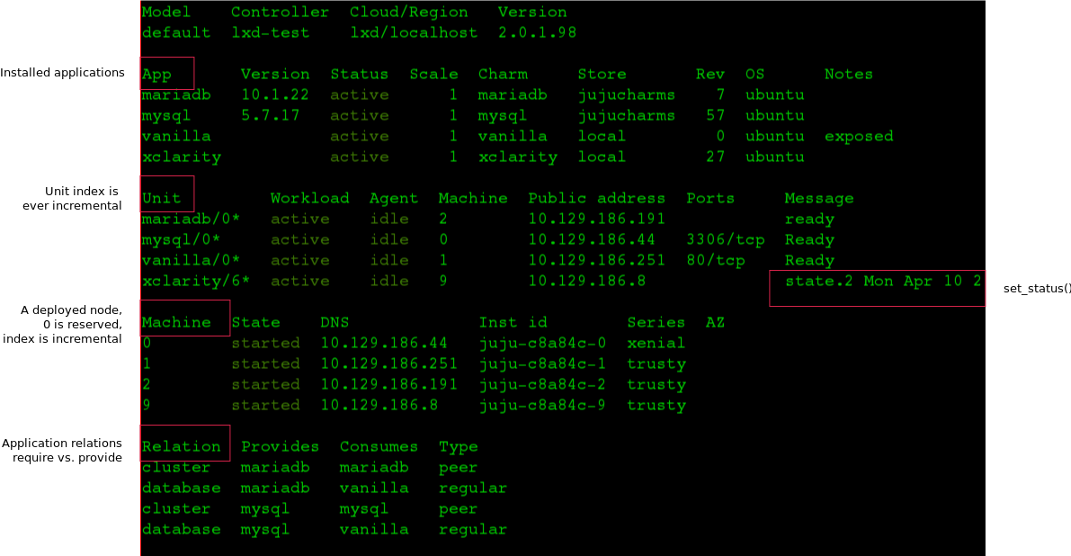
Juju status
Fig. $ juju status

Slide 24
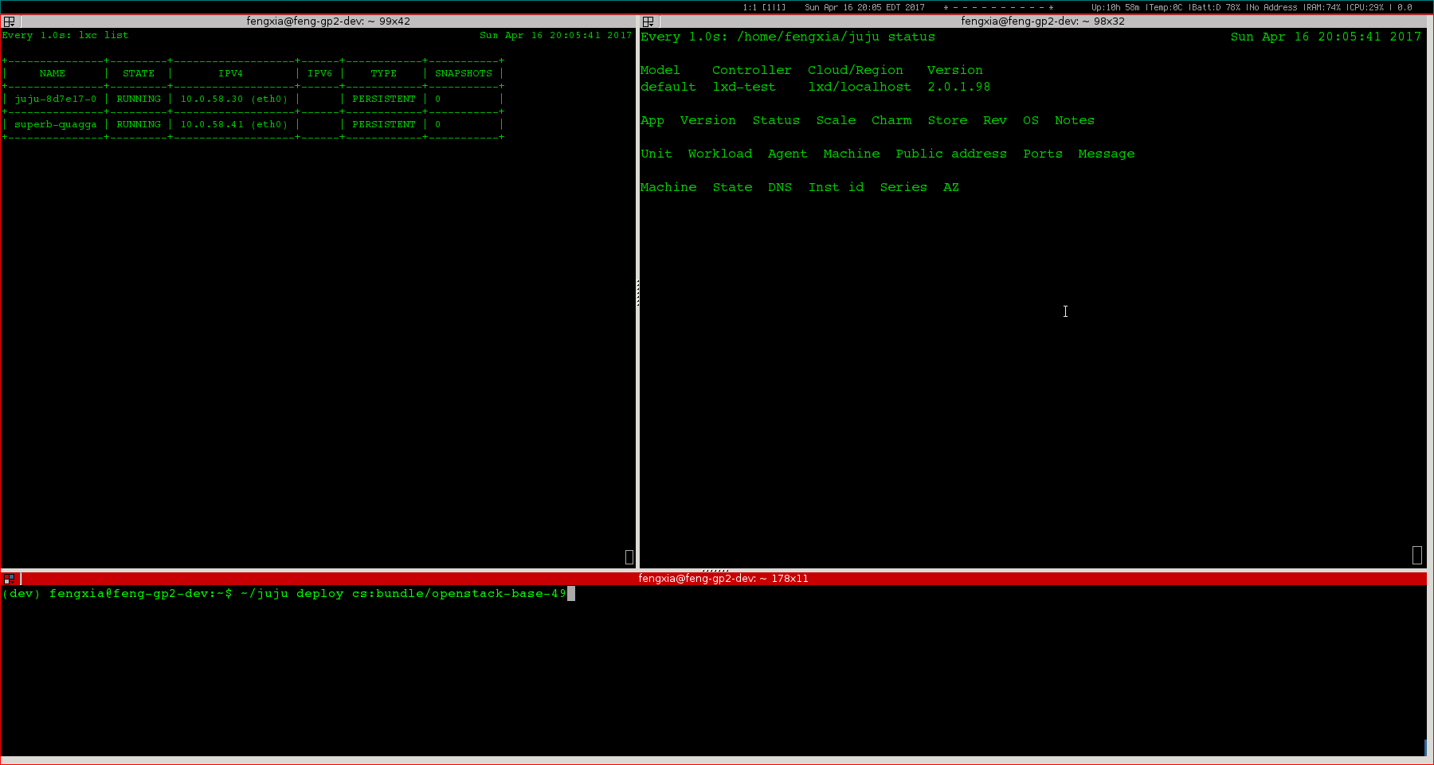
Demo: Openstack deploy (45s)
Deploy an Openstack onto LXD containers => 16 applications in 5 containers

Slide 25
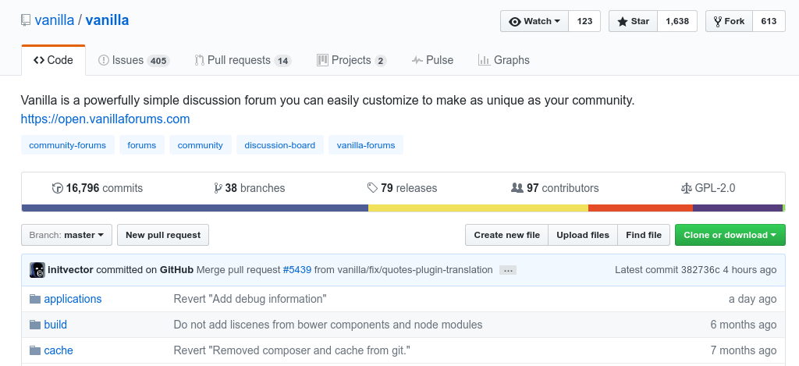
Demo: Vanilla (4min)

Slide 26
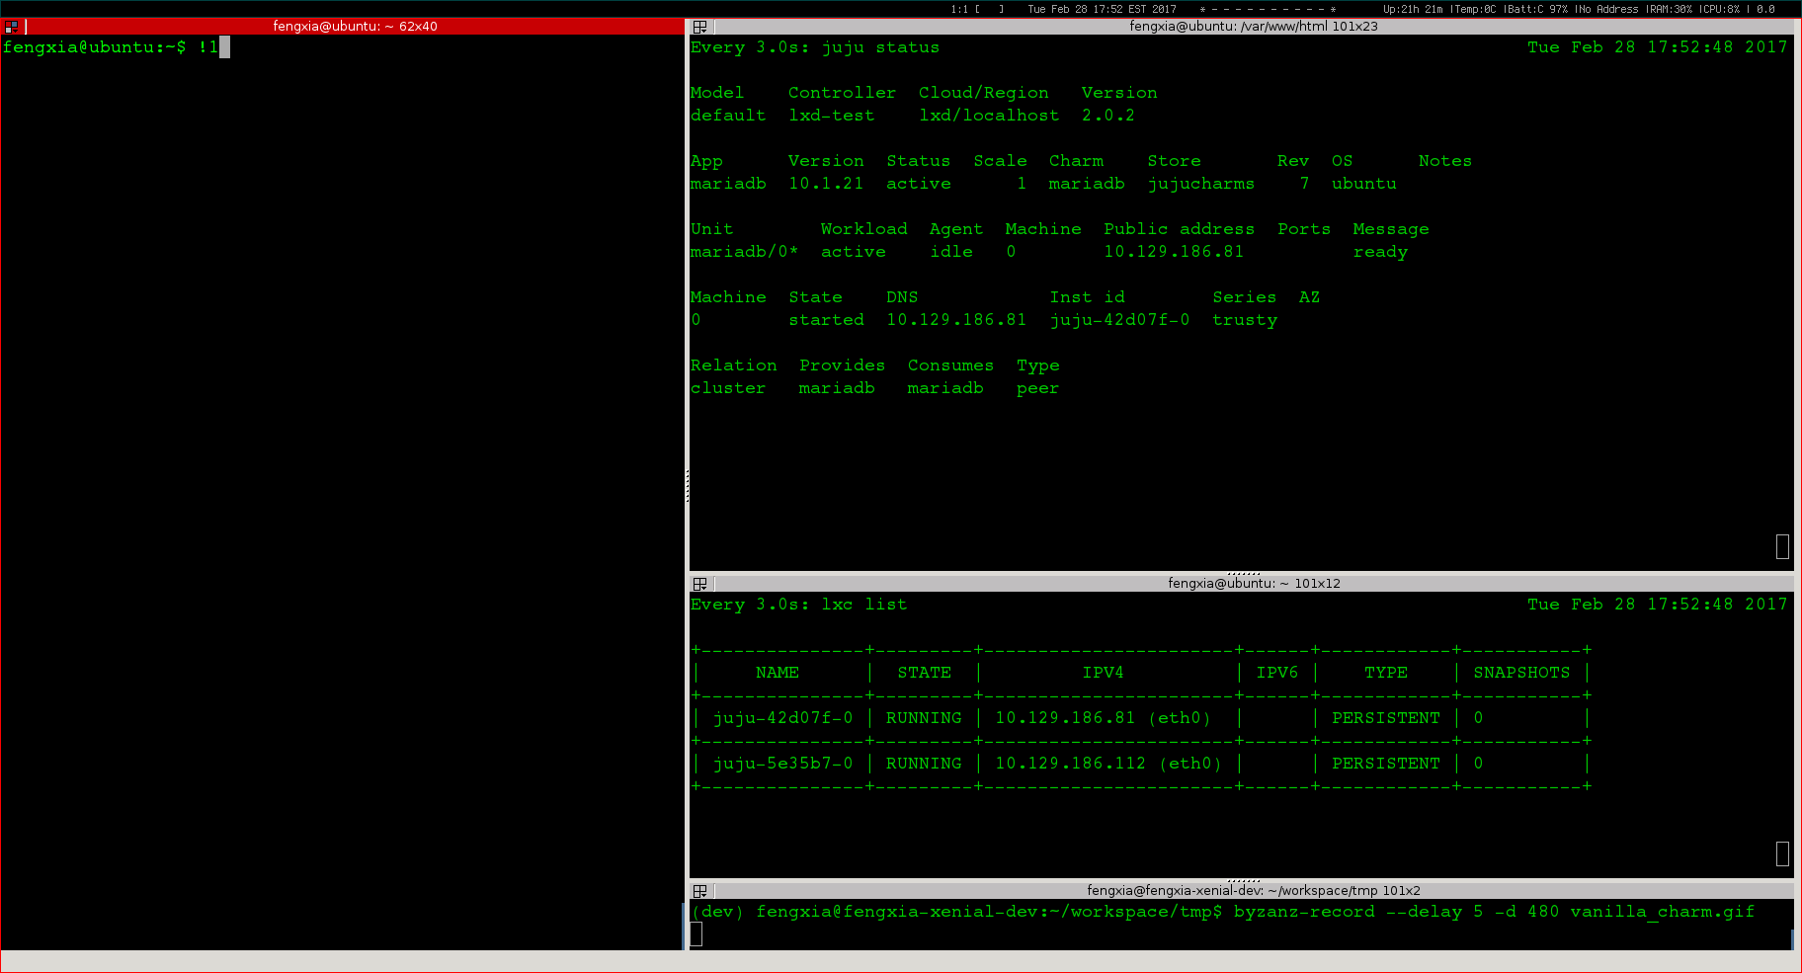
Demo: Vanilla (4 min)

Slide 27
Charm development

Slide 28
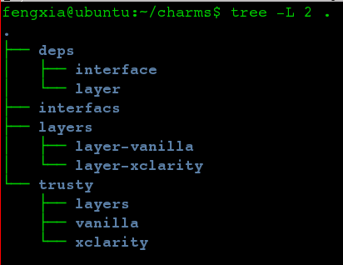
Write charm
Two ways to start
Modifying an existing simple charm that builds on “layer-basic”:
$ git clone http://github.com/juju-solutions/layer-vanilla.git
Scaffolding a template using “charm tools”:
$ charm create -t reactive-python [charm name]
Layer code
Compile charm
Charm dist dir
$ charm build
Deploy from local
$ juju deploy $JUJU_REPOSITORY/trusty/layer-alum --series xenial –to machine-id

Slide 29
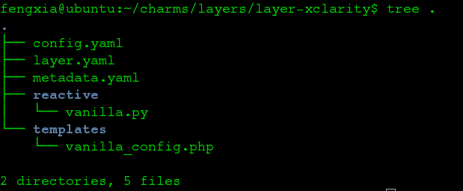
Code tree
config.yaml: config options. Can be loaded in the python files to enable flexible config
options:
myoption:
type: string
default: "x1"
description: “……"
metadata.yaml: charm meta. Defines charm name, compatible OS series, and relations.
layer.yaml:
Include layer:basic
List of reusable layers
Layers are packaged inside charm dist
interface.yaml: require & provide details
/reactive: custom code
Notes:
import yaml
import subprocess
from charmhelpers.core.unitdata import kv
from charmhelpers.core.hookenv import status_set
def config():
db = kv()
with open('django.yaml') as f:
django_cfg = yaml.safe_load(f.read())
for k, v in django_cfg.items():
db.set(k, v)
return db
def manage(cmd):
dcfg = config()
if not isinstance(cmd, list):
cmd = cmd.split(' ')
exe = [python(), 'manage.py']
extra = []
if dcfg.get('config-import'):
extra.append('--settings=%s' % dcfg.get('config-import'))
status_set('maintenance', ' '.join(['manage.py'] + cmd))
call(exe + cmd + extra)
def call(cmd):
dcfg = config()
subprocess.check_call(cmd, cwd=dcfg.get('source-path'))
def pip():
return config().get('pip', '/usr/bin/pip')
def python():
return config().get('python', '/usr/bin/python')
metadata
name: keystone summary: OpenStack identity service maintainer: OpenStack Charmers <openstack-charmers@lists.ubuntu.com> description: | Keystone is an OpenStack project that provides Identity, Token, Catalog and Policy services for use specifically by projects in the OpenStack family. It implements OpenStack’s Identity API. tags: - openstack - identity - misc series: - xenial - trusty - yakkety extra-bindings: public: admin: internal: provides: nrpe-external-master: interface: nrpe-external-master scope: container identity-service: interface: keystone identity-notifications: interface: keystone-notifications identity-admin: interface: keystone-admin identity-credentials: interface: keystone-credentials requires: shared-db: interface: mysql-shared pgsql-db: interface: pgsql ha: interface: hacluster scope: container domain-backend: interface: keystone-domain-backend scope: container peers: cluster: interface: keystone-ha

Slide 30
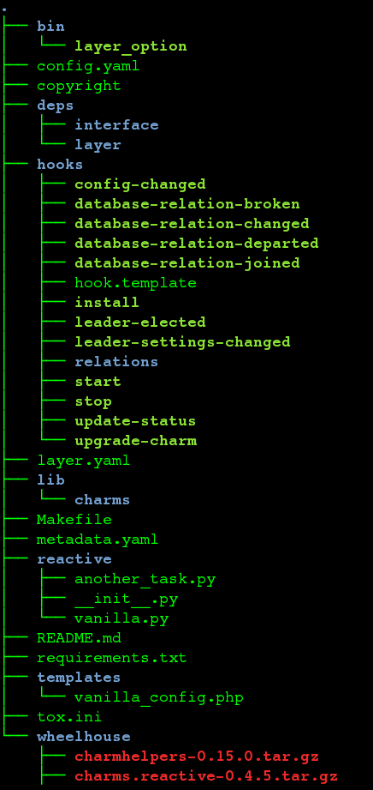
Dist tree
/deps/layer
layer-basic and others
/hooks
If not defined, it’s a copy of hook.template so they are always there.
/lib/charms
.py to install python virtualenv
Hardcoded python 3 and apt-get
/wheelhouse
charm-helpers
Charm.reactive
Notes:
import yaml
import subprocess
from charmhelpers.core.unitdata import kv
from charmhelpers.core.hookenv import status_set
def config():
db = kv()
with open('django.yaml') as f:
django_cfg = yaml.safe_load(f.read())
for k, v in django_cfg.items():
db.set(k, v)
return db
def manage(cmd):
dcfg = config()
if not isinstance(cmd, list):
cmd = cmd.split(' ')
exe = [python(), 'manage.py']
extra = []
if dcfg.get('config-import'):
extra.append('--settings=%s' % dcfg.get('config-import'))
status_set('maintenance', ' '.join(['manage.py'] + cmd))
call(exe + cmd + extra)
def call(cmd):
dcfg = config()
subprocess.check_call(cmd, cwd=dcfg.get('source-path'))
def pip():
return config().get('pip', '/usr/bin/pip')
def python():
return config().get('python', '/usr/bin/python')
metadata
name: keystone summary: OpenStack identity service maintainer: OpenStack Charmers <openstack-charmers@lists.ubuntu.com> description: | Keystone is an OpenStack project that provides Identity, Token, Catalog and Policy services for use specifically by projects in the OpenStack family. It implements OpenStack’s Identity API. tags: - openstack - identity - misc series: - xenial - trusty - yakkety extra-bindings: public: admin: internal: provides: nrpe-external-master: interface: nrpe-external-master scope: container identity-service: interface: keystone identity-notifications: interface: keystone-notifications identity-admin: interface: keystone-admin identity-credentials: interface: keystone-credentials requires: shared-db: interface: mysql-shared pgsql-db: interface: pgsql ha: interface: hacluster scope: container domain-backend: interface: keystone-domain-backend scope: container peers: cluster: interface: keystone-ha

Slide 31
CentOS compatibility
Two questions:
Will juju agent run on CentOS? Y.
Juju binaries can be executed on CentOS. Needs juju-mongo
Will Charm run on CentOS? N
Mostly Python scripts
Charms can run inside a python virtualenv
Python3 by default
Problems:
Layer-basic has hard-coded shell call to “apt-get”
http://stackoverflow.com/questions/23589971/yum-not-working, http://yum.baseurl.org/wiki/Faq
To make it work: update charm-helpers lib to implement CentOS packager.

Slide 33
Workload event lifecycle hooks
upgrade-charm
User upgrade
Once finish
install
config-changed
start
loop
Once finish
Once finish
The start
Update some config of the app
User stop
update-status
stop
Run regularly to detect the status of the charm
and send back to juju status
When user stop the all

Slide 34
Hook usage
Each charm execution is divided into serveral stage
install
config-changed
start
upgrade-charm
stop
update-status
leader-elected
Leader-settings-changed
Use the @hook(XX) to guide the execution process, install→config-changed→start
Use predefined python library to operate machine like network config or package install
https://jujucharms.com/docs/2.1/tools-charm-helpers
Also subprocess call can use the OS native cmds

Slide 35
System Architecture

Slide 36
Workload orchestration sequence diagram
Machine-0
Manager node. One per cloud environment. Keep agent states, serve CLI request, and command agents.
Agent
Runtime workload orchestrator. Distributed on each target node.
Charm store
Workload repository. Can be both local & remote.

Slide 37
Use case demo: a workload deployment (≈4 min)

Slide 38

System architecture overview
Blueprints
Command to deploy a workload
Hardware
configuration
ie. ThinkAgile
Software platform
Id. Openstack
User application
Ie. Hardoop
Workload metadata
Orchestration manager
3rd party software repo
Baremetal
provider
Cloud provider
ManageIQ
EC2
Ironic
Openstack
XClarity
Rackspace
Node state
Application state
MaaS
Azure
……
……
Platform specific instructions
Workload blueprints
Private Cloud
Public Cloud
Workload software payload

Slide 39
Function Architecture – Level 1
Blueprints
Blueprints
Descriptive template that defines workload states, actions, interfaces, and relations.
Hardware
Ie. ThinkAgile
Platform
Ie. Openstack
User application
Ie. Hadoop
Orchestration
Orchestration technology
Technology that defines terminologies, vocabulary, and runtime engine that enable automated blueprint deployment.
Description language
Orchestration runtime engine
Platform
Platform
Public cloud
Private cloud
Baremetal
Host environment that supports workload requirements and scales dynamically

Slide 40
Level 1 – Blueprints
**Hardware workload
Configure hardware within a hyper-converge rack to establish base line environment such as VLAN, boot sequence.
Blueprints
Platform workload
Hardware
Ie. TA
Platform
Ie. Openstack
User application
Ie. Hadoop
Install OS, agent, and application. Configure system and application to form software-defined platform such as Openstack.
Application workload
Install and configure application and its dependencies.
**
Lenovo innovation

Slide 41
Level 1 – Orchestration technology
Description language
Modeling language written in plain text that describes state, event, component, relation, parameters for installation and configuration.
Orchestration technology
Description language
Orchestration runtime engine
Orchestration runtime
Runtime binary that parse blueprint, responds to state change and event, and execute built-in function and custom scripts.

Slide 42
Level 1 – Platform
Public cloud
Amazon AWS
Azure
Rackspace
GCE
Platform
Private cloud
Public cloud
Private cloud
Baremetal
Openstack
ThinkAgile
Baremetal
Lenovo/xClarity cloud
HP
Dell

Slide 43
Function Architecture – Level 2
Workload Repository
Blueprint store
Workload Service
System optimization & big data
Workload Designer
Design, development and testing tools
Workload Orchestration Runtime System
Orchestration Manager
Central management server, one per platform service
Workload Manager
Distributed agent, one per deployment target
Software Platform Provider
Platform plugin interface & driver
Platform Service Provider
Host environment on demand

Slide 44
Function Architecture – Level 3
Workload Repository
Workload Service
Workload registry
Metadata service
Authentication
Version manager
Configuration filter
Utilization score card
Blueprint pipeline
Workload optimization
Workload Designer
Workload Orchestration Runtime System
Description language
Orchestration Manager
Workload Manager
API server
Node registry
Node lifecycle management
Node auditor
Workload downloader
Workload parser
Template creator
Data store
Configuration manager
Model manager
RPC interface
Workload installer
Workload cleaner
Workload compiler
Cloud provider plugin interface
Constraint checker
Workload version control
Websocket data transporter
State engine
API client
Workload linter
Node authentication
User CA generator
Workload agent provisioner
Worker thread manager
Error handler
Configuration management
Workload packaging mgt
Dry run sandbox
Software Platform Provider
Amazon EC2
GCE
Azure
Opensack
Cloudsigma
Rackspace
Workload editor
Joyent
Vsphere
MAAS
LXD container
Ironic
xClarity
Dependency illustrator
Platform Service Provider
Machine discovery
Machine inspection
Machine inventory
Power mgt
Network service
Storage service
Hypervisor service
Container service

Slide 45
Key Technology

Slide 46
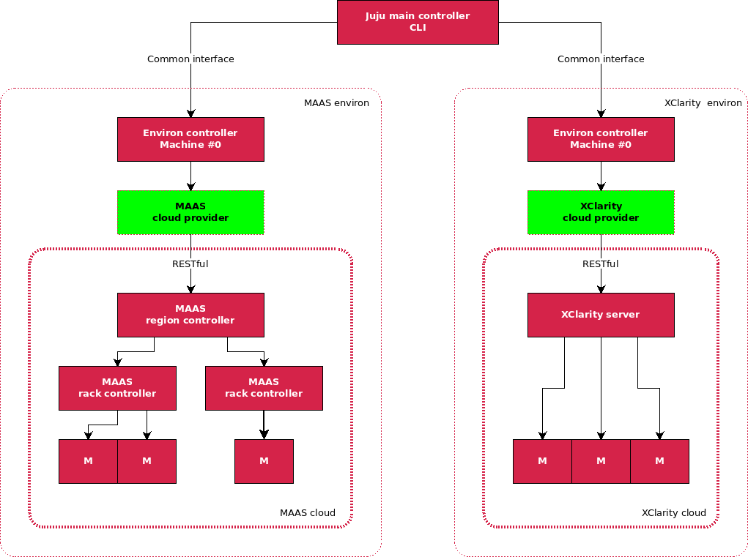
Juju - xClarity cloud model
xClarity cloud
Same configuration to support both public clouds and private cloud.
Extend “provider” to enable integration with xClarity.
Workload becomes “cloud” agnostic.

